Slide 1
CS300A Technical Communications Project Proposal
Acknowledgement: Slides courtesy to
Dr. Nitin Saxena
Dr. Rajat Mittal

Slide 2

What is a Proposal?
You’ve an idea.
You’re looking for support or funding.
Need to convince others.

Slide 3
Proposal Sections
Project Title
Project Overview
Motivation
Summary
Project Details
Architecture
Implementation Novelty
Resources & Budget
Evaluation
Deliverables
Timeline

Slide 4
Examples
http://s.casual.pm.s3.amazonaws.com/toolkit/ProposalExample.pdf
http://writing.engr.psu.edu/workbooks/proposal.samples.html
http://wwwcdn.howdesign.com/wp-content/uploads/2011/03/SampleProposal.pdf
http://web.cse.iitk.ac.in/~cs300/nlp.pdf

Slide 5

Project Title
Title should be a mini-abstract.
Paints a quick picture of ideas for the reader.
Focus. Remove the words that are unnecessary.
Single sentence. Two sentences require a colon (:) as a separator.
Include the names of coauthors and contributing institutions on the title page.

Slide 6
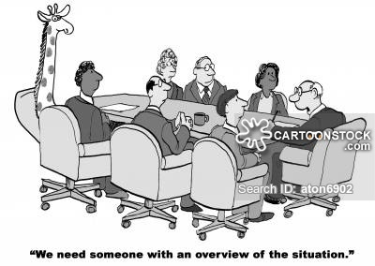
Project Overview
Be specific and concise.
It’s an Executive Summary.
Avoid details.
Form a strong impression in reviewer’s mind.
Prepare this after you’ve figured out the details.

Slide 7
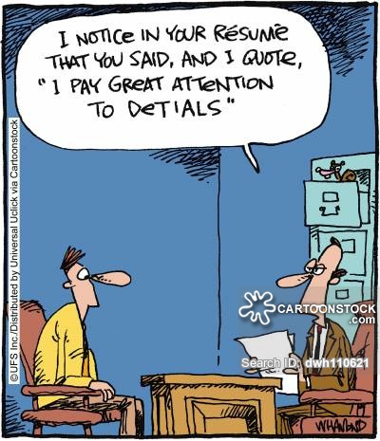
Project Details
What is the project environment? Tools?
What are the challenges and solutions?
Why are you unique?
What is achieved in the end (and in the middle)?

Slide 8
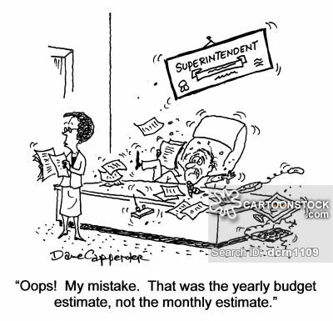
Resources & Budget
Checklist of the resources needed.
Expected expenses.
Categorize!
Proper justification.

Slide 9

Evaluation
Clear objectives. Deliverables.
Give an evaluation plan.
Timeline.
Sustainability.

Slide 10

Wrapping up
In the Conclusion, you can summarize
the problem & motivation.
the solution.
the contribution.
the future.

